Slide 1
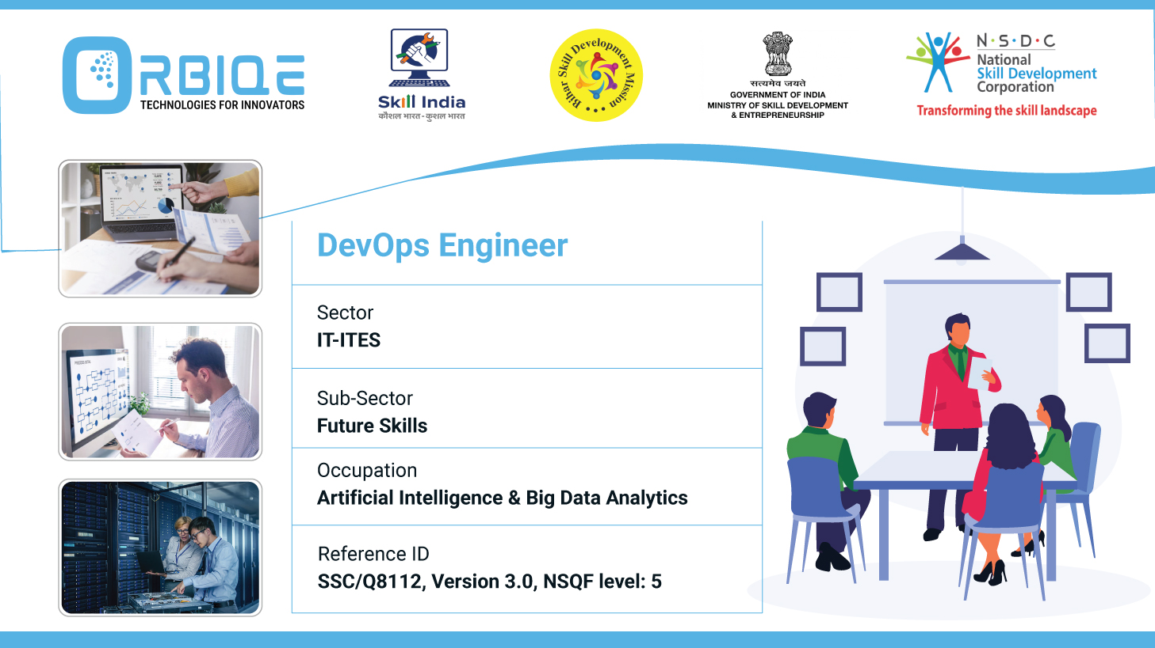
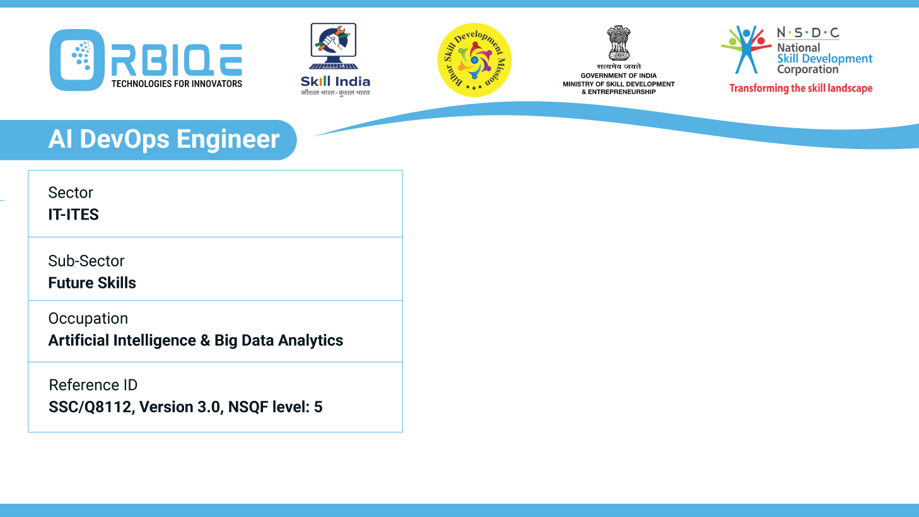
Name- Krishna Kant Dubey

Slide 2

CRUD Mastery: Adding, Deleting, Modifying, and Updating Data

Slide 3
Agenda
Use the CRUD function to add, delete, modify, or update data in databases, mastering the fundamental operations for data manipulation

Slide 4
CRUD Fundamentals
Operation | Purpose | SQL Keywords | NonSQL(MongoDB)
Create | Add new data | INSERT | insertOne(), insertMany()
Read | Retrieve existing data | SELECT | find(), findOne()
Update | Update existing data | UPDATE | updateOne(), updatedMany()
Delete | Remove data | DELETE | deleteOne(), deleteMany()

Slide 5
SQL CRUD Examples (Using PostgreSQL or MySQL)
CREATE
INSERT INTO users (name, email) VALUES ('Krishna’,
'krishna@example.com’);
READ
SELECT * FROM users WHERE name = 'Krishna’;
UPDATE
UPDATE users SET email = 'newemail@example.com' WHERE name = 'Krishna’;
DELETE
DELETE FROM users WHERE name = 'Krishna';

Slide 6
NoSQL CRUD Examples (Using MongoDB)
CREATE
db.users.insertOne({ name: "Krishna", email:"krishna@example.com" });
READ
db.users.find({ name: "Krishna" });
UPDATE
db.users.updateOne( { name: "Krishna" }, { $set: { email: "newemail@example.com" } });
DELETE
db.users.deleteOne({ name: "Krishna" });

Slide 7
Thank You

